Slide 1
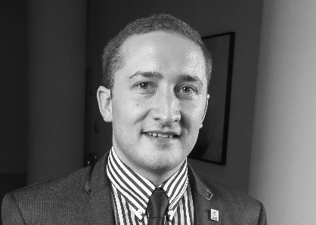
Architectural Technologists Register (ATR)
June 2023
.
James Banks
CIAT Membership Director
Shadow ATR Registrar
ATR

Slide 2
Shadow Register Update - 2023
Meeting held with Minister Burke and DHLGH on 7 December 2022, where they agreed to amend primary legislation next time the Building Control Act was reviewed and implement the ATR as a Statutory Register and enable Full Registrants to act as Assigned and/or Design Certifiers. Reaffirmed by Minister O’Donnell on 19 April.
DHLGH must be satisfied with administrative capacity of the ATR, before due process can begin to amend primary legislation and implement a Statutory Register for Architectural Technologists.
ATR moved from a voluntary Register to a shadow Register on 1 May 2023.
Formalising the four Boards listed in the Building Control Act 2007:
Assessment Board
Admissions Board
Professional Conduct Committee
Appeals Board
ATR

Slide 3
ATR Shadow Register Milestones
A ball park figure and/or % of Chartered ATs as Full Registrants by May 2024.
ATR must be a viable entity to gain support in the legislative process from the DHLGH.
Staffed office in the Republic of Ireland.
Two cycles of Full Registrant subscription payments are required before the DHLGH would support the process towards statutory recognition. DHLGH have been advised that proposed first subscription payment is in May 2023 with renewal in May 2024.
Update meetings with DHLGH, as necessary to be held post launch of the shadow Register leading up to summer 2024.
ATR

Slide 4
ATR and CIAT Ireland Centre
CIAT will continue to support the ATR and are working towards the milestones and deliverables outlined by the DHLGH.
Centre has identified industry professionals to sit on the respective ATR Boards, but a wider pool to approach and consider would be beneficial.
ATR Registrations Assistant (being recruited) and Region 15 and Centre 02 are your local points of contact and are here to support.
ATR office will be 83 Amiens Street, Dublin.
Start up cost will be paid back to CIAT when Register is Statutory.
ATR

Slide 5
Application process for Chartered ATs
A self-declaration confirming their experience and capability to act as an Assigned and/or Design Certifier supported by a counter signatory on a Statutory Register in the Republic of Ireland. Signatory not required, if on a Statutory Register.
An up-to-date CV.
A letter from CIAT confirming they meet the Educational (Stage 1) and Practice (Stage 2) Standards as defined in the ATR Professional Standards Framework for registration and eligibility to become a Full Registrant.
Pay the €200 ATR subscription at time of application.
Submission to meet bullet points 1, 2 and 4 to atr@ciat.global will trigger the letter from CIAT as per bullet point 3 to complete the application for review by the Admissions Board.
The Admissions Board would accept the documents detailed in bullet points 1, 2 and 3 to enable election within 8 weeks on to the Shadow Register as a ‘Full Registrant’.
ATR

Slide 6
Qualifying with ATR/CIAT – for non Chartered ATs
Achieved by completing the ATR Professional Assessment:
Measured against the ATR Professional Standards Framework and reviewed by Assessment Board.
Stage 1 Educational Standards — CIAT Accredited Honours/Masters degree or equivalent
Stage 2 Practice Standards — Designing, Managing, Practising and Developing (self) via assessment of work experience
For Chartered Architectural Technologist, MCIAT
Stage 3 Professional Standards — Professional Interview
€195 ATR assessment fee plus €200 ATR subscription.
ATR

Slide 7
Stage 1: Educational Standards
Demonstrate your knowledge and understanding.
Outline where and how you have built up your base of knowledge:
relevant academic/professional qualification/s;
CPD/training courses;
manuals/literature; and
reflective practice.
Your Referee may choose to use questions, research project, case studies or a simulation to ascertain your knowledge.
ATR

Slide 8
Stage 2: Practice Standards
Collect and collate evidence as appropriate/attained.
Outline ability to perform against Practice Standards [Designing, Managing, Practising and Developing (self)] criteria.
The following should be recorded:
name of project/s being used;
how it satisfies/demonstrates experience;
your role within the process/es; and
where the evidence is located.
Once satisfied with explanations and evidence, qualified professional who acts as Referee signs off as appropriate.
ATR

Slide 9
How can the AT profession help?
Chartered Architectural Technologists to apply to join the Shadow Register and pay €200 subscription.
Commit to join one of the ATR Boards via an Expression of Interest.
Promote the launch and objectives of the shadow Register within your networks.
Educate, engage and gain support from industry contacts and stakeholders.
AT professionals and students to join CIAT and/or either register their intent or submit an application for Registration with the ATR.
Continue to apply pressure and engage in pursuit of parity for ATs.
Identify suitable non ATs to sit on the respective Boards.
ATR

Slide 10
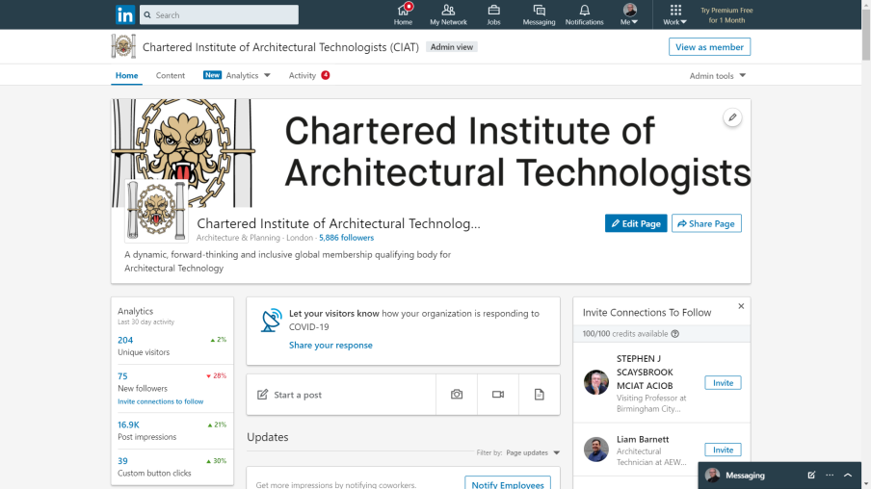
Here to help
Architectural Technologists’ Register
83 Amiens Street, Dublin 1
Tel: 00353 1876 4666
www. architecturaltechnologistsregister.ie
atr@ciat.global
ATR

